Slide 1

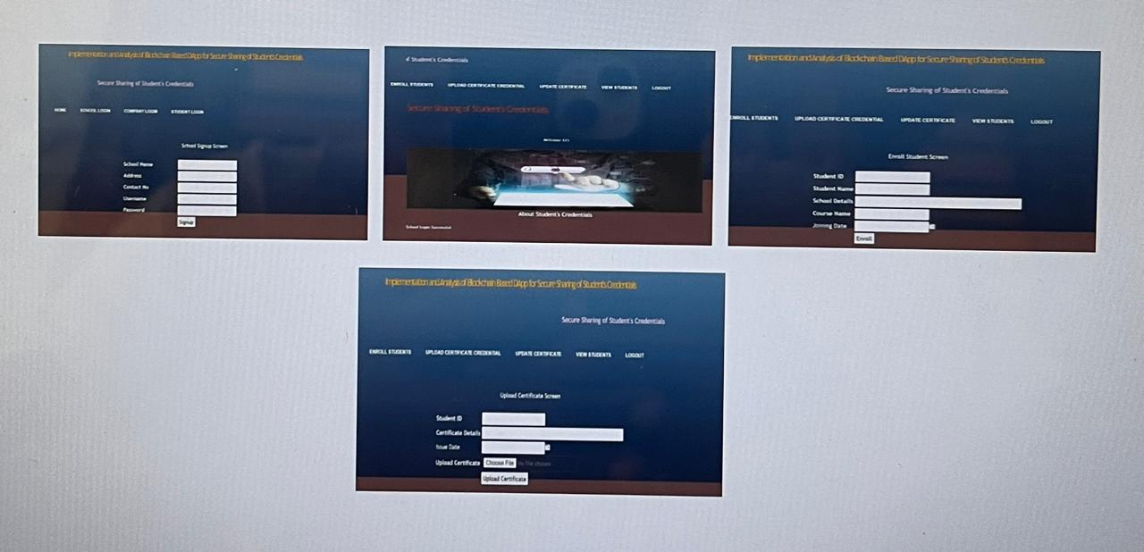
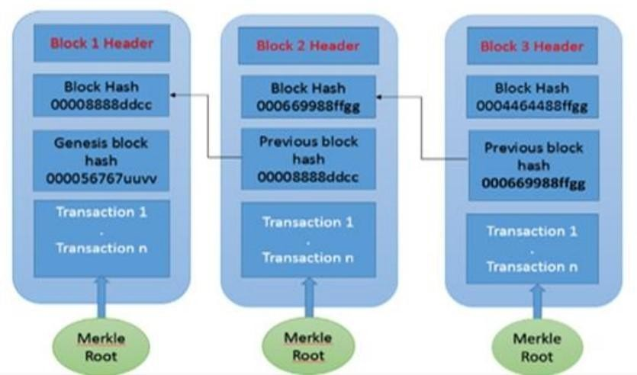
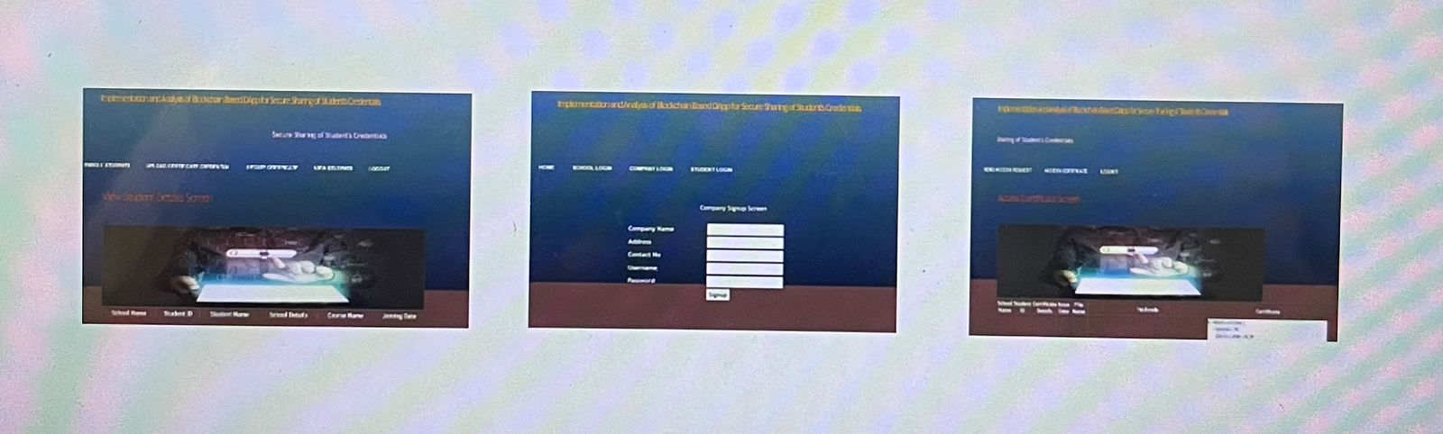
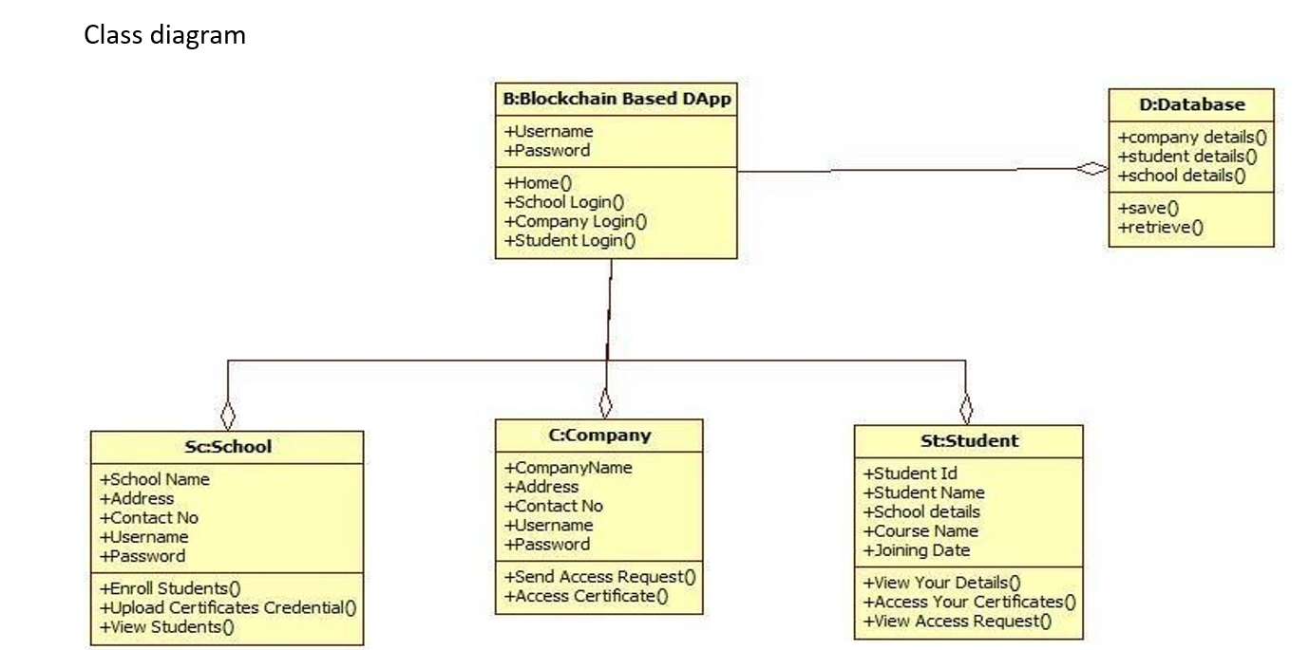
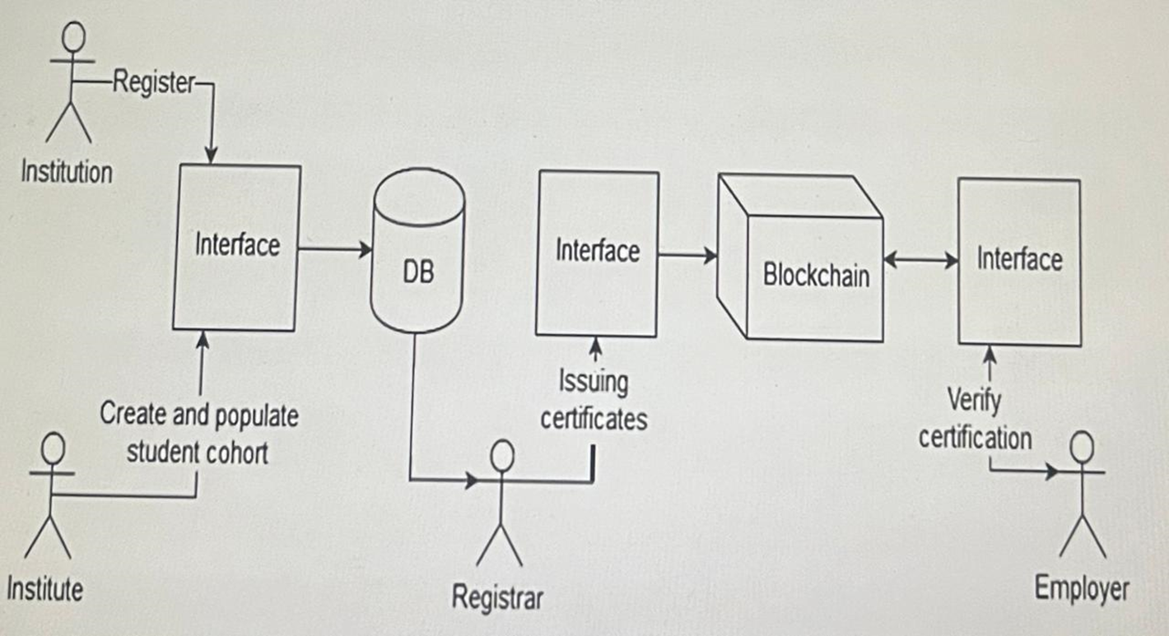
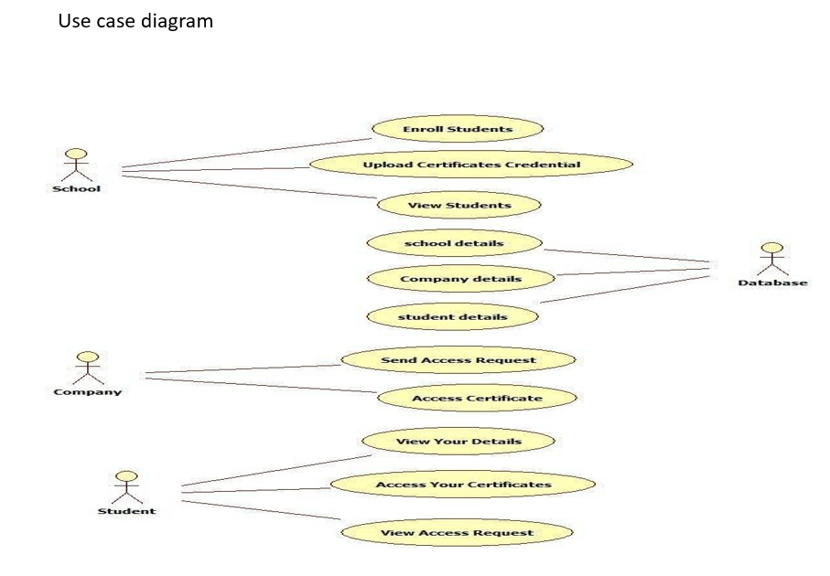
Blockchain based solution for verification of Educational certificates
2103A51337 2103A51262 2103A51379 2103A51193
GUIDE: N.Venkatesh
ASSISTANT PROFESSOR
SCHOOL OF CS&AI
G.Pavan kumar D.Tharun T.Rithwik B.Vasu
ABSTRACT
LITERATURE REVIEW
RESULTS
PROPOSED SYSTEM/ARCHITECTURE
The proposed decentralized certificate verification system that uses blockchain technology can potentially solve the issues mentioned above. By using a decentralized system, the data would not be stored on a single server that could be hacked or lost if the system crashes. Instead, the data would be stored on multiple nodes in the network, making it more secure and less vulnerable to attacks. In addition, the use of blockchain technology provides anti-tampering mechanisms, making it difficult for anyone to forge or manipulate certificates. Each certificate would be cryptographically connected to the previous certificate in the chain, creating a tamper-proof system that is difficult to hack. Moreover, the proposed system would provide faster certificate verification and issuance. Since the data would be stored on multiple nodes, verification could be done quickly without the need for human intervention. This would reduce the time and resources required for verification and issuance, making the process more efficient and cost-effective. Overall, the proposed decentralized certificate verification system that uses blockchain technology can potentially solve the issues associated with the current certificate issuance, verification, and validation process. By using a decentralized system with anti-tampering mechanisms, the system can provide a more secure and efficient way of verifying and issuing certificates, reducing the time and cost required for the process.
Fake certificates are a big problem and the usual way of checking them takes a lot of time and is expensive. This study proposes a solution that uses blockchain technology to verify identity, which is faster and more efficient. It also has a system to revoke certificates if they are fake. The system is easy to use and does not require special skills. A prototype has been created and it has features like data privacy, verifying transcripts, and sharing data only with those who need to see it.
The purpose of this research is to develop a secure and efficient system using blockchain technology for storing job training certificates. By using public blockchain, the certificates are protected from being forged or altered. Smart contracts are utilized to create data blocks that are added to the Ethereum blockchain network. The certificate files are stored in a distributed environment called Inter Planetary File System (IPFS), which provides secure and quick access. The research showed that certificate data can be safely stored on Ethereum public blockchain and supporting files on IPFS.
The Cooperative Intelligent Transportation System (CITS) is an innovative technology that enables vehicles to communicate with each other, enhancing road safety. However, ensuring secure communication remains a significant challenge in the research community. The existing solutions for inter-vehicle communication security mostly rely on digital certificates' authentication.
However, the computation required for such verification is highly expensive and imposes significant overhead on vehicles, and the validation must be performed within a specific time frame. Moreover, depending on a central node for certificate issuance and revocation may create a single point of failure, risking motorist safety.
QUANTITATIVE RESULTS OF THE PROPOSED METHOD
CONCLUSION
INTRODUCTION
• In this Research Work, a Blockchain-based Educational Certificate Verification decentralized application ramed DiUcerts was developed in the Ethereum Blockchain platform.
• The first objective of this research work was achieved by the progressive and effective implementation of the proposed model and also developed DApp.
• This paper is introduced to avoid the middleman or any third party in the certificate verification process.
• One of our goals is to diminish the cost and time of the verification process. Surprisingly, this paper evaluates the cost of the proposed decentralized app, and it cost less than a dollar without any server maintenance cost.
• However, the main challenge of this paper is to eradicate fake educational certificates and our DApp almost met all the conditions to fight against this fraud and scam channel.
• In conclusion, from this work, this paper encourages that developers should be considered the Ethereum Blockchain platform for developing decentralized applications on Blockchain and it will turn into an interesting sector for the upcoming generation.
These essential credentials play a vital role in an individual’s life, and a secure and efficient process for issuing and sharing them is essential. The use of blockchain technology can provide a secure and tamper proof solution for these critical documents, ensuring that they remain trustworthy and valuable throughout an individual’s lifetime.
To enhance security of the issued credentials, educational institutes make use of numerous methods like assigning unique identification number, putting uniquely distinguishable hologram, affixing student’s passport sized photograph, printing the details of the students like date of birth, place of birth, parents’ name, registration/enrollment number, etc. Moreover, at the time of recruitment process, companies also need to verify the credentials that it receives directly from the applicants. Indeed, many times, companies contact the parent institution to endorse the credentials it has received from applicants. Such kind of process is tedious, costly and time-consuming. Some of the recent papers that have presented the benefits and the challenges of using blockchain technology in education. However, there is still a need to design a working prototype of student-credential sharing platform which can offer services for all the stakeholders in the education ecosystem.
Blockchain Features
Decentralized: The blockchain network is not controlled by any single entity, such as a government or company.
Improved Security: The decentralized nature of the blockchain makes it more secure than traditional centralized systems because there is no single point of failure.
Distributed Ledgers: The blockchain maintains a public ledger of transactions that is distributed across the network of users.
Consensus: The blockchain network uses a consensus mechanism to ensure that all transactions are valid and accurate. Faster Settlement: Transactions on the blockchain can be settled more quickly than traditional banking systems, which can take several days.
PROPOSED SYSTEM ARCHITECTURE
REFERENCES
1. T. Nguyen, “Gradubique: An academic transcript database using blockchain architecture,” 2018.
2. J. Hope, “Give students ownership of credentials with blockchain technology,” The Successful Registrar, vol. 19, no. 1, pp. 1–7, 2019.
3. J. Rooksby and K. Dimitrov, “Trustless education? A blockchain system for university grades,” in New Value Transactions: Understanding and Designing for Distributed Autonomous Organisations, Workshop at DIS, 2017.
4.M. Li et al. CrowdBC: A Blockchain-Based Decentralized Framework for Crowdsourcing. IEEE Trans Parall Distrib Syst, 30(6), 1251-1266 (2019) https:// doi.org/10.1109/TPDS.2018.2881735.

